Slide 1
Artificial Intelligence
Artificial Intelligence(AI) refers to the simulation of human intelligence in machines that are programmed to think like humans and mimic their actions.
Branches of AI are :-
Machine Learning
Deep Learning
Natural Language Processing
Robotics
Expert Systems
Fuzzy Logic

Slide 2
Machine Learning
Machine learning(ML) is a type of artificial intelligence that allows software applications to become more accurate at predicting outcomes without being programmed to do so.
Machine Learning algorithms use historical data as input to predict output values.
There are three types of machine learning :-
Supervised learning
Unsupervised learning
Reinforcement learning

Slide 3
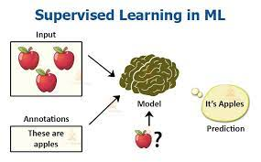
Supervised Learning
When a input is provided as a labelled dataset, a model can learn from it and this kind of learning is called supervised learning.

Slide 4
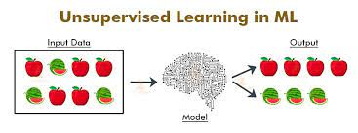
Unsupervised Learning
There is no complete and clean labelled dataset in unsupervised learning.
It is a type of self-organised learning that helps find previously unknown patterns in data sets without pre-existing labels.

Slide 5
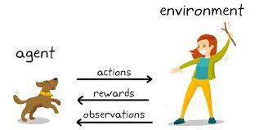
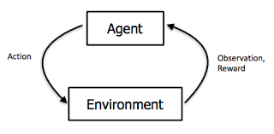
Reinforcement learning
It is about taking suitable action to maximize reward in a particular situation.
It works on basis of a reward and penalty system.

Slide 6
Types of problems in supervised learning
Regression problems
They are responsible for continuous data.
Example: For predicting the price of a piece of land in a given area.
The input is sent to the machine for predicting the price according to previous instances.
The machine them determines a function that would map the pairs.
Classification problems
They ask the algorithm to predict a discrete value that can identify the input data as a member of a particular class or group.
Example: For determining whether a student has passed or failed from a particular set of students.

Slide 7
Components of Machine Learning Algorithm
Features
It refers to the inputs given to the algorithm.
Labels
It refers to the outputs given by the algorithm.
Model
It refers to the mathematical equation used to solve the function.
INPUT
MODEL
(Features)
ML Algorithm
OUTPUT
(Functions)
(Labels)

Slide 8
Type of ml algorithms
Linear Regression
Non Linear Regression
Logistic Regression
Decision Tree
Random Forest
KNN ( K Nearest Neighbours )
SVM ( Support Vector Machine )
Naïve Bays Algorithm

Slide 9
Linear regression
Linear regression analysis is used to predict the value of a variable based on the value of another variable.
The variable you want to predict is called the dependent variable.
The variable you are using to predict the other variable's value is called the independent variable.

Slide 10
NON Linear regression
This type of statistical model (also known as logit model) is often used for classification and predictive analytics. Logistic regression estimates the probability of an event occurring, such as voted or didn't vote, based on a given dataset of independent variables.

Slide 11
LOGISTIC REGRESSION
This type of statistical model (also known as logit model) is often used for classification and predictive analytics. Logistic regression estimates the probability of an event occurring, such as voted or didn't vote, based on a given dataset of independent variables.

Slide 12
DECISION TREE
A decision tree is a flowchart-like structure in which each internal node represents a "test" on an attribute (e.g. whether a coin flip comes up heads or tails), each branch represents the outcome of the test, and each leaf node represents a class label (decision taken after computing all attributes).

Slide 13
RANDOM FOREST
Random forest is a commonly-used machine learning algorithm trademarked by Leo Breiman and Adele Cutler, which combines the output of multiple decision trees to reach a single result. Its ease of use and flexibility have fueled its adoption, as it handles both classification and regression problems

Slide 14
KNN (K NEAREST NEIGHBOUR)
The k-nearest neighbors algorithm, also known as KNN or k-NN, is a non-parametric, supervised learning classifier, which uses proximity to make classifications or predictions about the grouping of an individual data point.

Slide 15
SVM (SUPPORT VECTOR MACHINE)
Support Vector Machine or SVM is one of the most popular Supervised Learning algorithms, which is used for Classification as well as Regression problems.

Slide 16
NAÏVE BAYS ALGORITHM
The Naïve Bayes classifier is a supervised machine learning algorithm, which is used for classification tasks, like text classification. It is also part of a family of generative learning algorithms, meaning that it seeks to model the distribution of inputs of a given class or category.

Slide 17

Cloud Computing
Cloud computing is on-demand availability of computer resources, especially data storage and computing power, especially data storage and computing power, without direct management by the user.
Large clouds often have functions distributed over multiple locations, each location being a data centre.
Common cloud providers are Amazon Web Services, IBM, Microsoft Azure.

Slide 18
Types of Cloud Computing
1. Infrastructure-as-a-Service(IaaS)
It delivers fundamental compute, network and storage resources to consumers on-demand, over the Internet and on a pay-per-use basis.
Using cloud infrastructure enables companies to save on the cost of acquiring, managing and maintaining their own IT infrastructure.
2. Platform-as-a-Service(PaaS)
It provides users a complete cloud platform- hardware, software and infrastructure- for developing, running and managing applications without the cost, complexity and inflexibility of building and maintaining that platform on-premises.
Software-as-a-Service(SaaS)
It offers software access online via a subscription, rather than IT teams having to buy and install it on their individual systems.
They enable software access anywhere, anytime, as long as there is an Internet connection.

Slide 19
Types of Fitting in Machine Learning
Underfitting :-
It means that the model makes, but initially incorrect predictions.
This happens when the model is too simple for the data.
Overfitting :-
It means the model does not make accurate predictions.
This happens when the model is too complex for the data.
3.Optimum fitting :-

Slide 20
OOPS Concept
Objects
They are the basic unit of OOPS representing real life entities that are invoked with the help of methods declared within a class.
Class
They are a predefined or user-defined from which objects are created, it represents methods that are common to all objects within a class.
Inheritance
It refers to parent-child relationship where the child class gains the parent class features.
Multiple Inheritance
It refers to parent-child relationship where the child class gains features of more than one parent class.
Polymorphism
It is when a single function can be assigned and can perform several actions.
Encapsulation
It is a means of binding data variables and methods together in a class and only objects of a class can be allowed to access these entities, this is know as data hiding and helps in insulation of data.

Slide 21
Google Colaboratory
Colaboratory or “Colab” for short allows anybody to write and execute arbitrary python code through the browser, and is especially well suited to machine learning, data analysis, and education
On Colab Python runs on a server (not in the local browser or on the local computer) and we can easily use it to interact with an online database and analyze data in situations where we need to keep the code private.

